Slide 1

Product value modelling of summer clothes in E-commerce Wish
Group 11
BSTAT 5325, Sec-003
(Devi Prasad Chitti Pothula, Jitesh Khemchandani, Bharath Kumar Reddy Peram, Faria Tasnim)

Slide 2
Table of Contents
Data Overview
Description of Dataset
Identification of Qualitative and Quantitative Variable
Cleaning and Preparing data for EDA
Exploratory Data Analysis
Statistical description of Dataset
Validating the correlations between variables
Finalizing the variables to run the models
Model Fitting
Cluster Analysis
Regression Analysis
Model Output
Equation for high value product

Slide 3
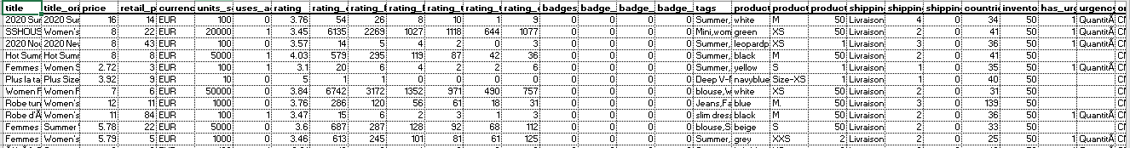
Raw Data
Data Overview
Sales of summer clothes in E-commerce Wish.
Dataset contains product listings as well as products ratings and sales performance.
In total it has 43 cols and 1573 rows.
Found 34 duplicate records in the entire data set and those were removed.
19 out of 43 columns are either in text or with same value for all the records. Removed from analysis.
Though Data has many columns, Qualitative and Quantitative data which we use in analysis are countable on fingers.
Data Source: https://www.kaggle.com/jmmvutu/summer-products-and-sales-in-ecommerce-wish

Slide 4
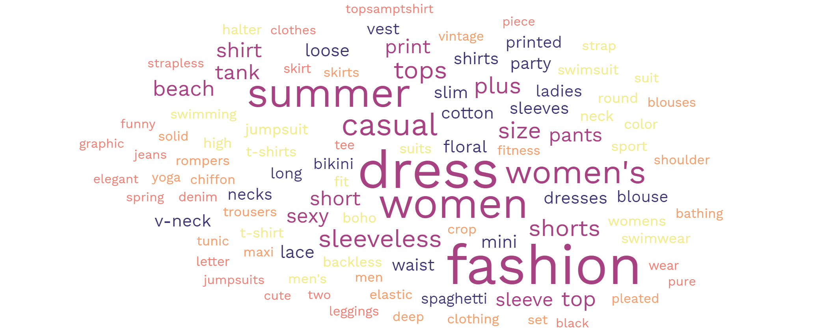
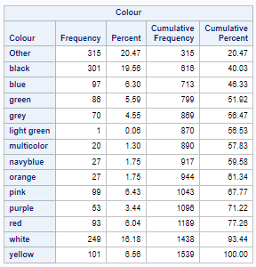
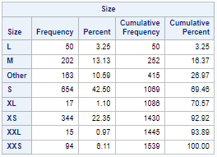
Description of qualitative and quantitative Data (1)
Data Overview
The catalog has got different mix of colors, sizes and tags. We are trying to test does any particular color, size and tag impacts the sales.

Slide 5
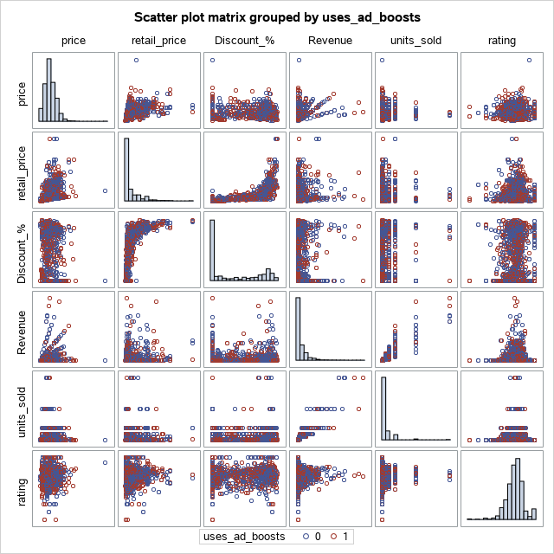
Scatter plot matrix
Data Overview
By looking at the plots, we have identified that there is possibility to divide the data into clusters using the Discount_% and rating.

Slide 6
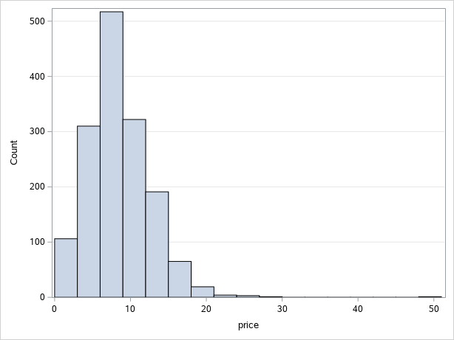
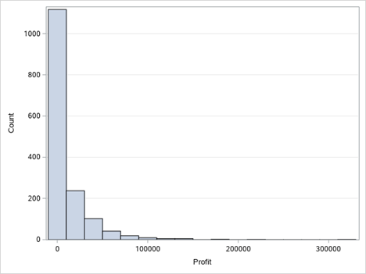
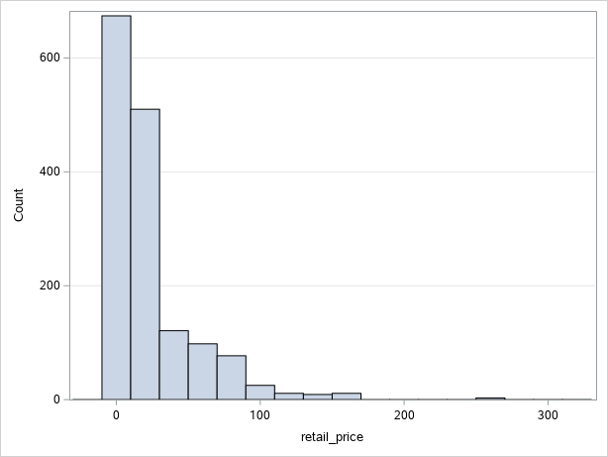
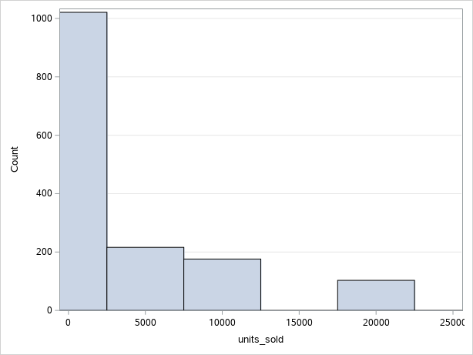
Description of qualitative and quantitative Data (2)
Data Overview
price: Price at which the product sold to customer.
profit: Profits earned in August 2020.
retail_price: Price at which the product supposed to be sold to customer.
units_sold: Number of units sold in August 2020.
Looking at the price variable distribution, we can clearly say that most of the products fall in the range of 0 – 20 even though their retail prices are in the range of 0 – 100.

Slide 7
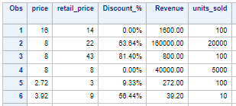
Data Preparation (Additional Data columns)
Data Overview
Using the available data, we have created an extra column names Discount_% which gives the % discount applied on each product using selling price and the retail price
Revenue column is created for considering it as profit factor. Revenue on each product is units sold times of selling price
We are using revenue for calculating profit on each product

Slide 8
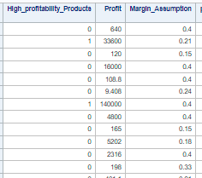
Data Preparation (Additional Data columns)
Data Overview
In order identify the Profit we have made an assumption for profit margin in the range of 12%-40% based on discount% with in intervals of 10%.
Profit for each product is calculated using revenue*margin
Top 20 percentile products are assumed as High value products
We considered profit as a response variable for running model

Slide 9
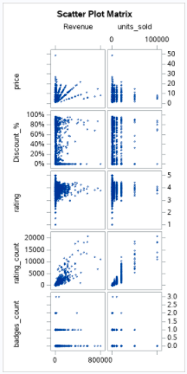
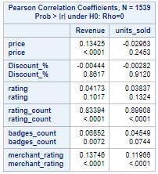
Exploratory Data Analysis (EDA)
EDA
Though we do not see any strong correlation for revenue with any variable, we see a meaningful correlation among units_sold and rating_count

Slide 10
Exploratory Data Analysis (EDA)
EDA
Though we do not see any strong correlation for revenue with any variable, we see a meaningful correlation among units_sold and rating_count

Slide 11
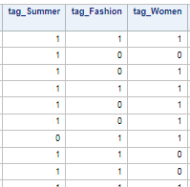
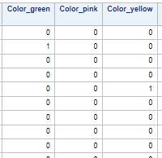
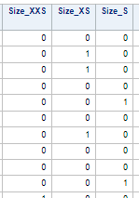
Data Preparation (Dummy Variables)
EDA
Dummy variable columns are created for the available meaningful classification variables to test if they playing any role in increasing revenue

Slide 12
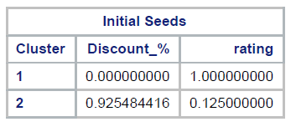
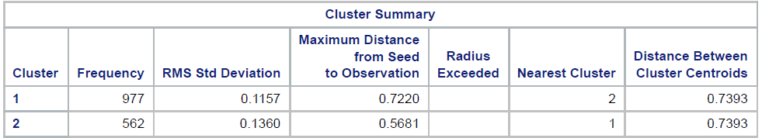
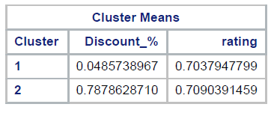
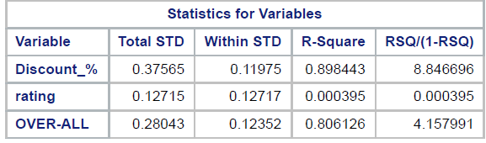
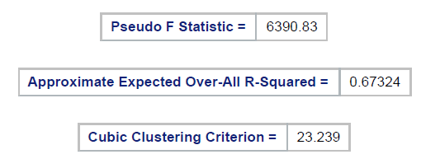
Identifying Clusters
Model building
We have divided data into two clusters with frequency of 977, 562.
Based on the discount % and rating plot, we can create a clusters analysis which might show an significant impact in our analysis

Slide 13
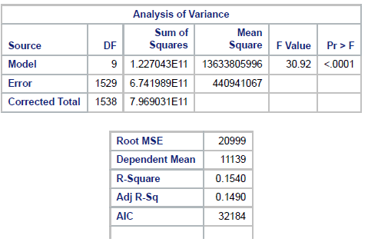
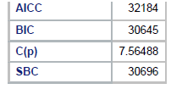
Regression Analysis
Model building
We ran multiple regressions to identify the best fit of model and to generate an equation for product potential value in Eur per month.

Slide 14
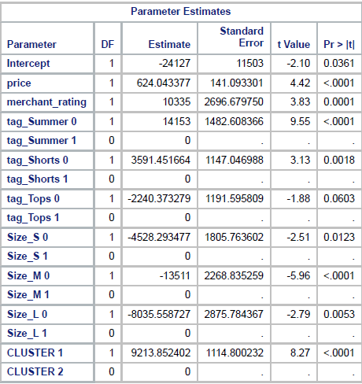
Regression Analysis
Model building
We ran multiple regressions to identify the best fit of model and to generate an equation for product potential value in Eur per month.

Slide 15
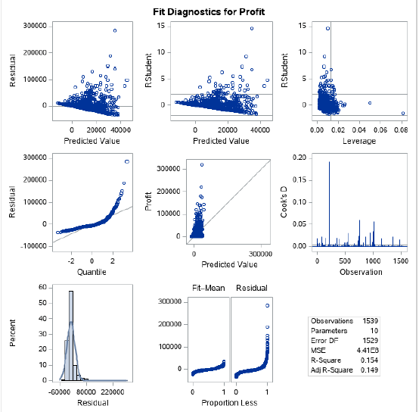
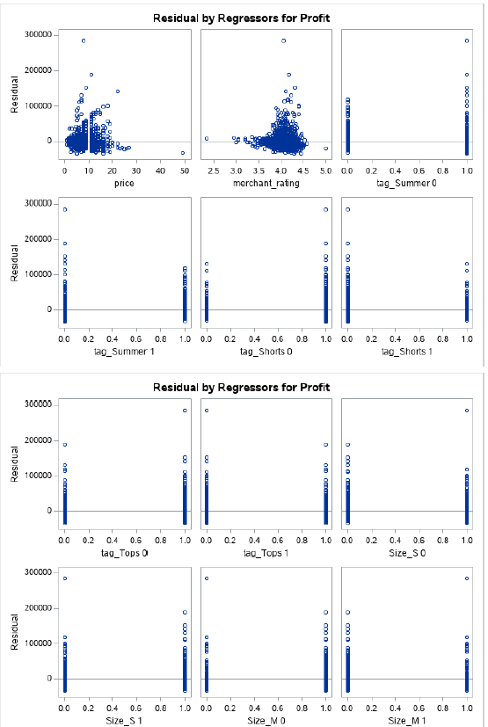
Regression Analysis
Model building
We ran multiple regressions to identify the best fit of model and to generate an equation for product potential value in Eur per month.

Slide 16
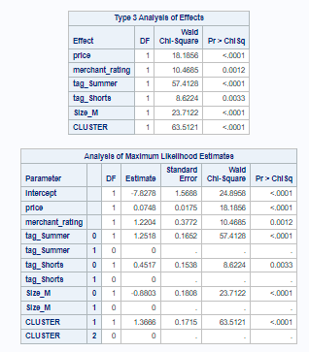
Model building
Logistic Regression Analysis
We ran logistic regression to get an equation to identify whether a product fall under is high potential value product.

Slide 17
Product value equation
Model output
Equation of Product potential value:
For Cluster 1:
Product Potential Value = 624.0433*price + 10335*merchant_rating + 14153*tag_summer + 3591.4516*tag_shorts - 2240.373*tag_tops - 4528.2934*Size_s – 13511*size_M – 8035.5587*Size_L + 9213.8524-24127
For Cluster 2:
Product Potential Value = 624.0433*price + 10335*merchant_rating + 14153*tag_summer + 3591.4516*tag_shorts - 2240.373*tag_tops - 4528.2934*Size_s – 13511*size_M – 8035.5587*Size_L -24127
Our goal is to finalize an equation which sellers can use to identify the product value before investing on it to add in inventory

Slide 18
High value Product prediction
Model output
Equation to Predict High potential value product:
For Cluster 1:
High_potential_product = 0.0748*price + 1.2204*merchant_rating + 1.2518*tag_summer + 0.4517*tag_shorts-0.8803*Size_M + 1.3666 – 7.8278
For Cluster 2:
High_potential_product = 0.0748*price + 1.2204*merchant_rating + 1.2518*tag_summer + 0.4517*tag_shorts-0.8803*Size_M – 7.8278
Our goal is to finalize an equation which sellers can use to identify the product value before investing on it to add in inventory

Slide 19
Appendix

Slide 20
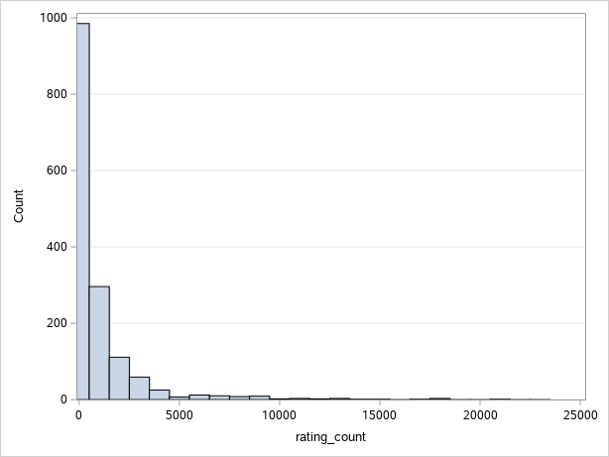
Description of qualitative and quantitative Data (2)
Data Overview
units_sold: Number of units sold in August 2020
rating_count: Number of users rated the products
Not every user who purchase the product gives rating, still count of rating would be one major variable which drives the customer behaviour

Slide 21
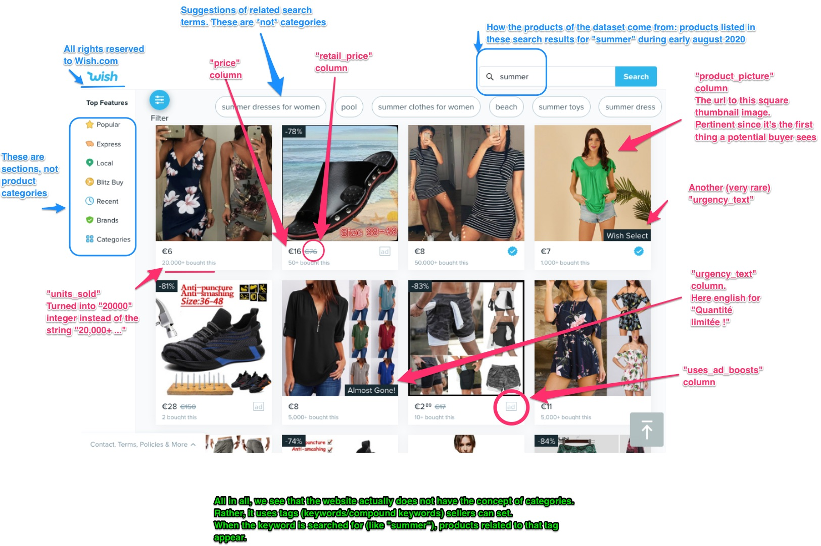
Pictorial representation of each Variable
Data Overview

Slide 22
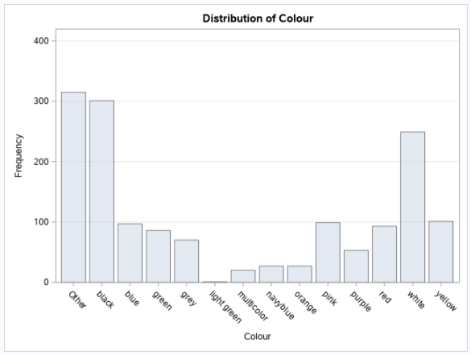
Data preparation
Data Overview
The catalog has got different mix of colors, we are trying to test does any particular color impacts the sales. For this we have taken top ten colors with high frequency and grouped rest of the colors in ‘other’

Slide 23
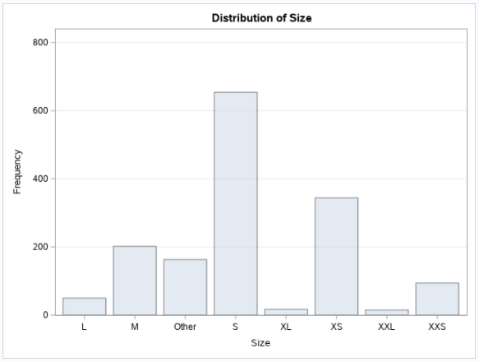
Description of qualitative and quantitative Data (5)
Data Overview
The catalog has got different mix of size, we are trying to test does any particular size impacts the sales.

